Slide 1
US Accident Prediction
Presented By:
Michael Wholey
Badiri Nadh Mamidi
Sai Brahma Naidu Katuri
Naga Satish Mediboina

Slide 2
Problem Overview
Every year, the number of traffic accidents increases, although most of them might be avoided if everyone was a little bit more cautious.
There are some circumstances that affect accidents more than others; if this is the case, how can we identify these factors and use them to inform our decisions? This could help us reduce the number of accidents that occur on the road.
we reasoned that why not develop a model to analyze such a real-world dataset to identify the variables that are most strongly correlated with actual accidents and to predict accidents in real time?

Slide 3
Approach to problem
Our initial thought was, why not utilize the information to train some models, then use those models to determine which factors are most responsible for an accident?
These include the weather, the time of day, the period of the year, wind chill, wind speed, and precipitation. Based on user input, the same methodology can be applied to anticipate accidents in real-time.
This would allow early warning systems or indications to help direct police/firefighter attention during bad accident times
This would allow us to find hotspots or particular conditions which can worsen accidents

Slide 4
About the Dataset
We have used the US Accidents dataset from Kaggle, which has accident data from 2016-2021.
It includes a number of elements that have been assembled from a range of sources and can aid in the model's training. On the Kaggle website for the dataset, more details are available.
https://www.kaggle.com/datasets/sobhanmoosavi/us-accidents
The "Severity" feature will serve as our goal variable for training the models.
Severity is a rating of the impact of the accident ranging from 1-4
Other attributes are split across several types: Weather, Location, etc.
Close to 3 million observations

Slide 5
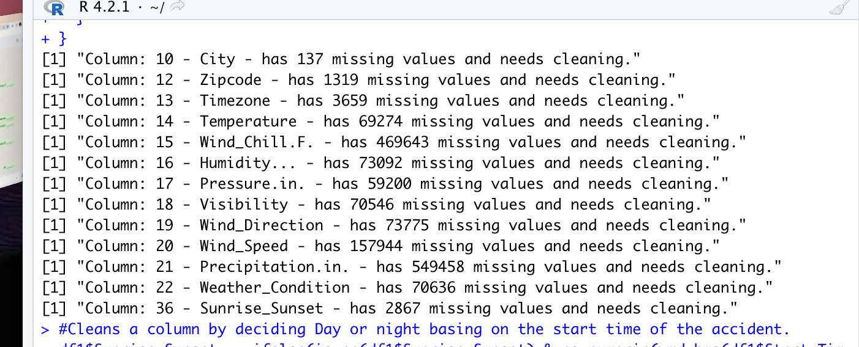
Cleaning Process I
We have lots of Missing values, some columns have *Very* high missing percentages, and others are only low missing percentages.
We also have redundant columns that are not useful
We have some rows that are missing lots and lots of columns
Remove some features that are highly correlated which can help us in reducing overfitting.
<Missing Value Chart Insert>

Slide 6
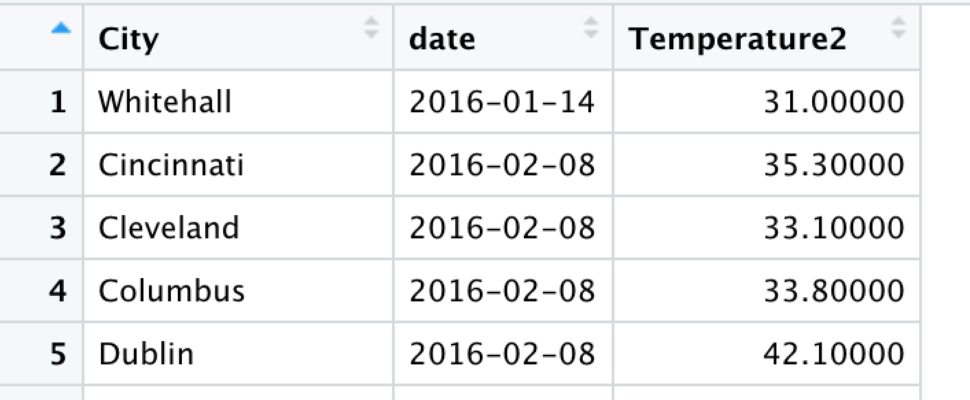
Cleaning Process II
We try to impute values for certain columns where possible.
For example, for Temperature, we take the temperature from other accidents in that city on that date and apply that to any missing values we have.
We follow a similar process for several other variables as well.
We drop some columns that are redundant.
At the end, we have a small number of rows which were missing many values and we drop those as well.
We are still left with over 2 million observations.

Slide 7
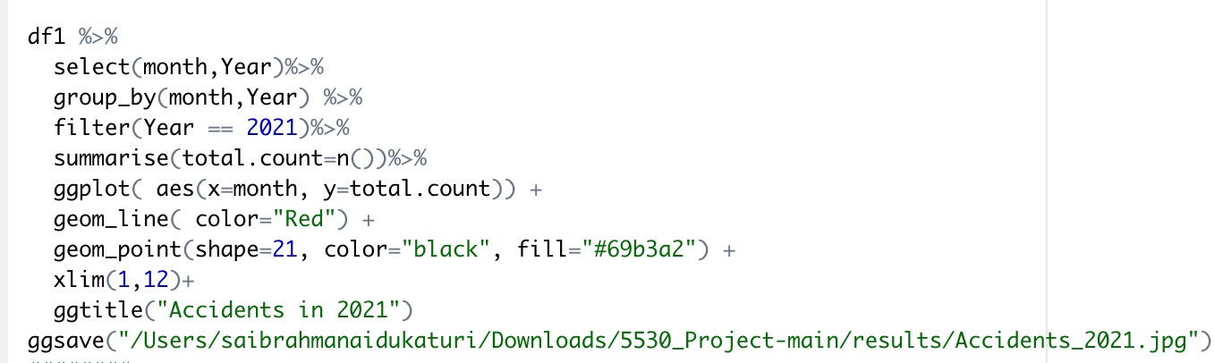
Beginning of Analysis Charting
With 47 columns in this dataset, we are handling a total of 47 features, which is slightly bit excessive. We'll try to get rid of a few of them and perhaps combine some into one column.
Below is the snippet for number of accidents in the year 2021

Slide 8
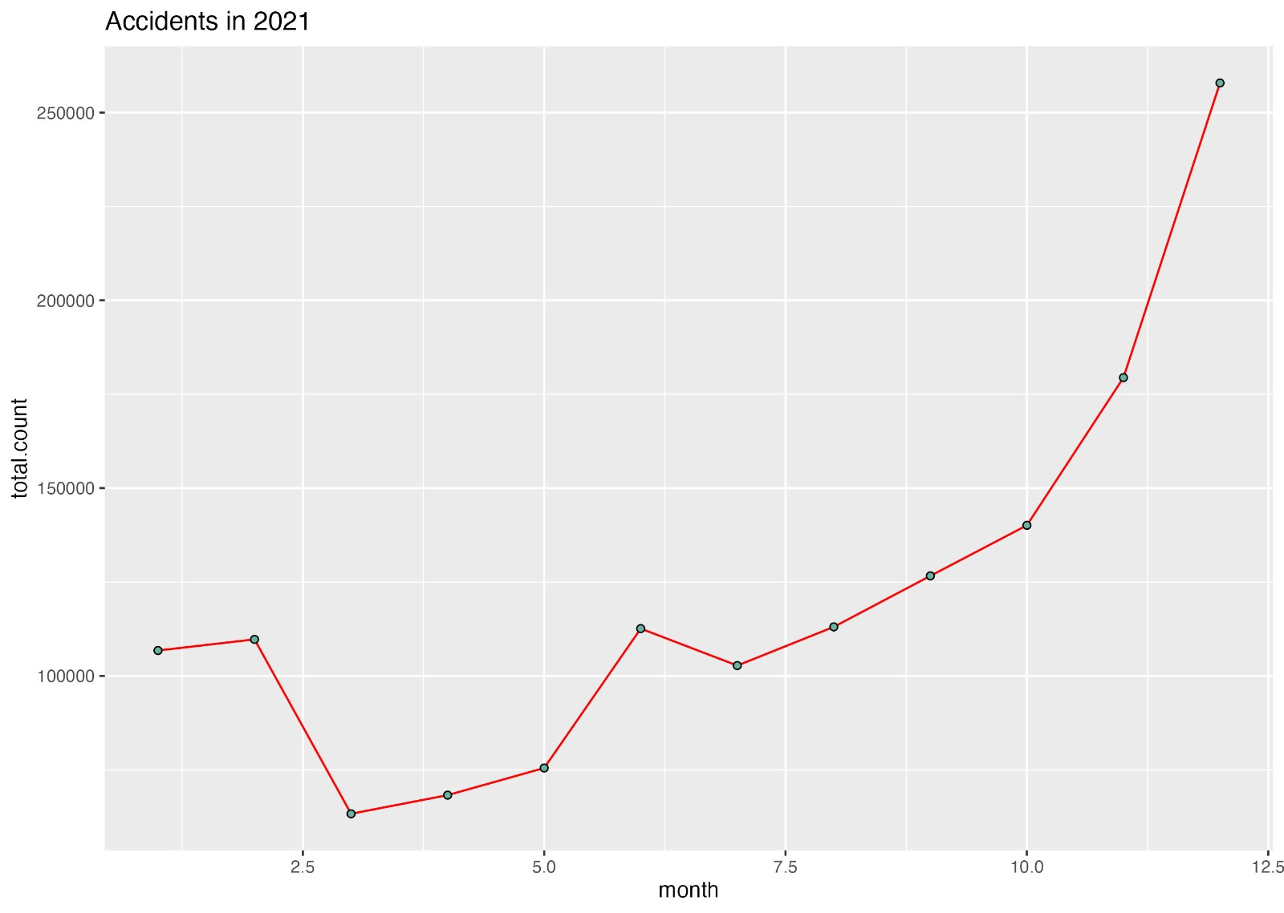
Chart
This graph gives information of accidents in the year 2021
This tells us that usually, the number of the accident is going up by the end
of the year.

Slide 9
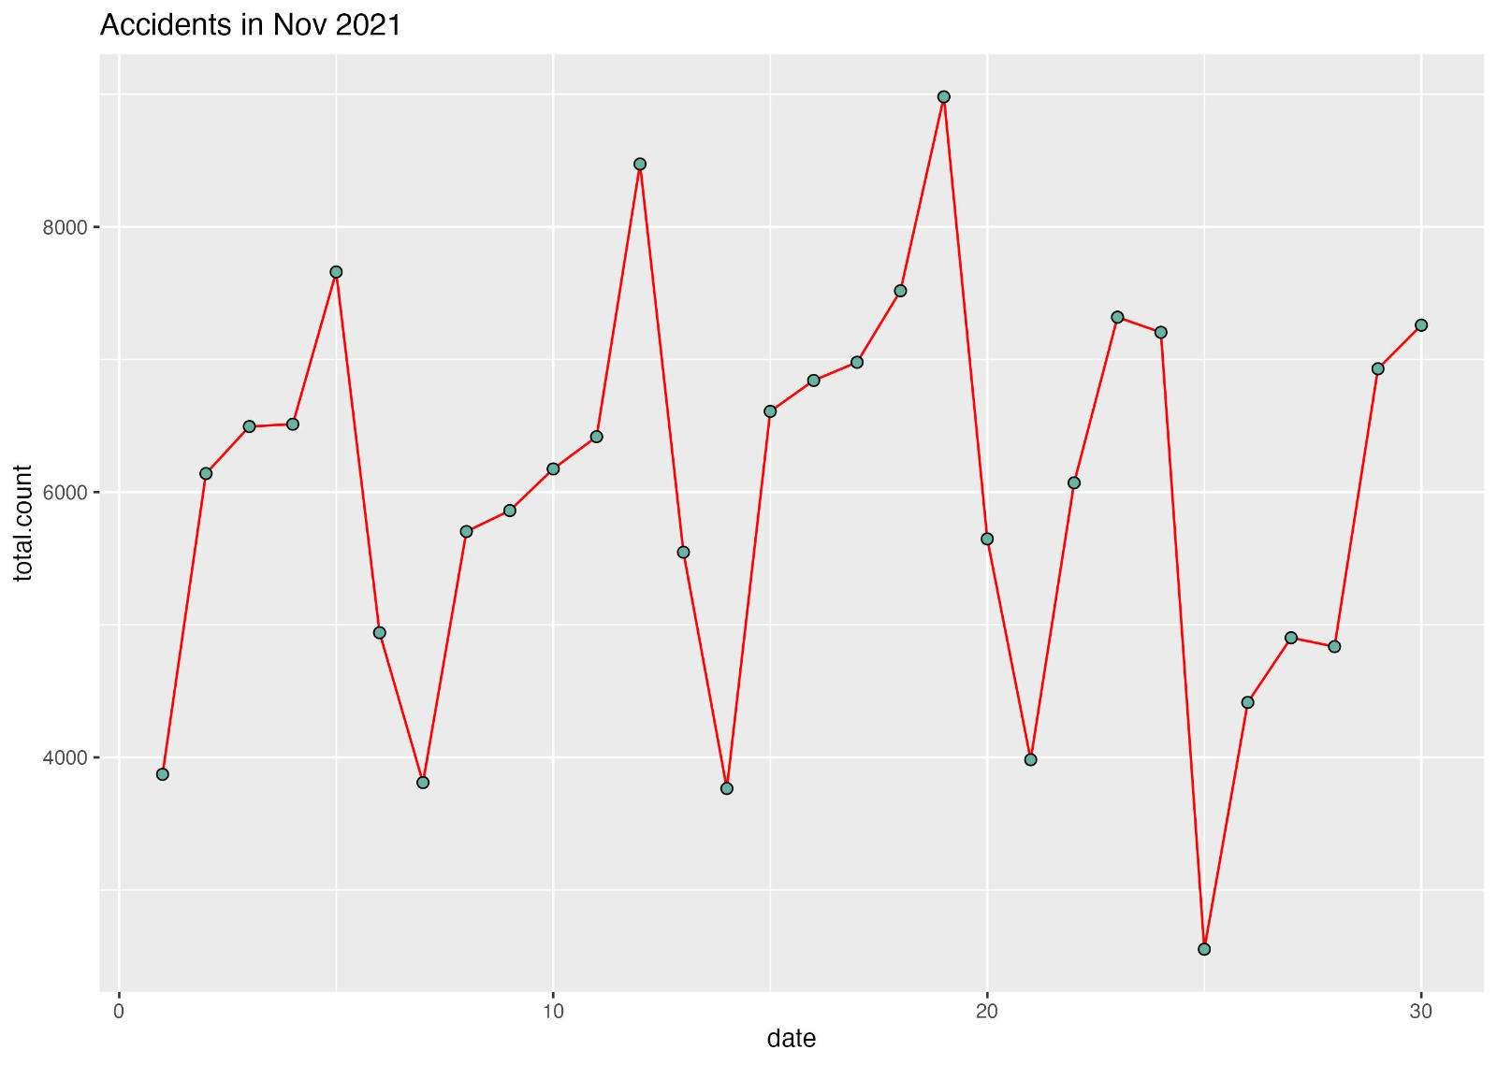
This graph gives more detailed information about the month of November which has the highest number of accidents. it gives information about the accidents happening weekly.

Slide 10
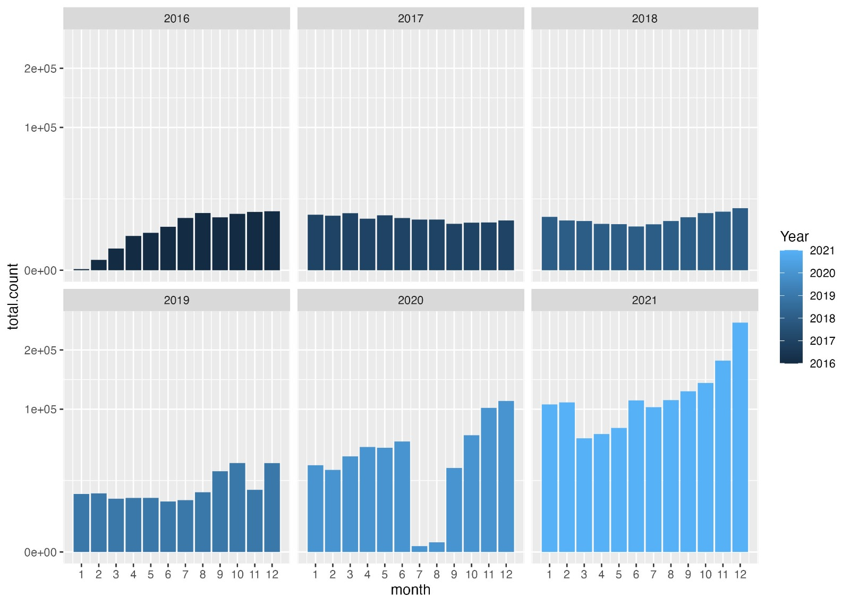
This graph gives detailed information about the accidents by year and by month. This give the information that accidents are increasing by year because of the increase in vehicles.

Slide 11
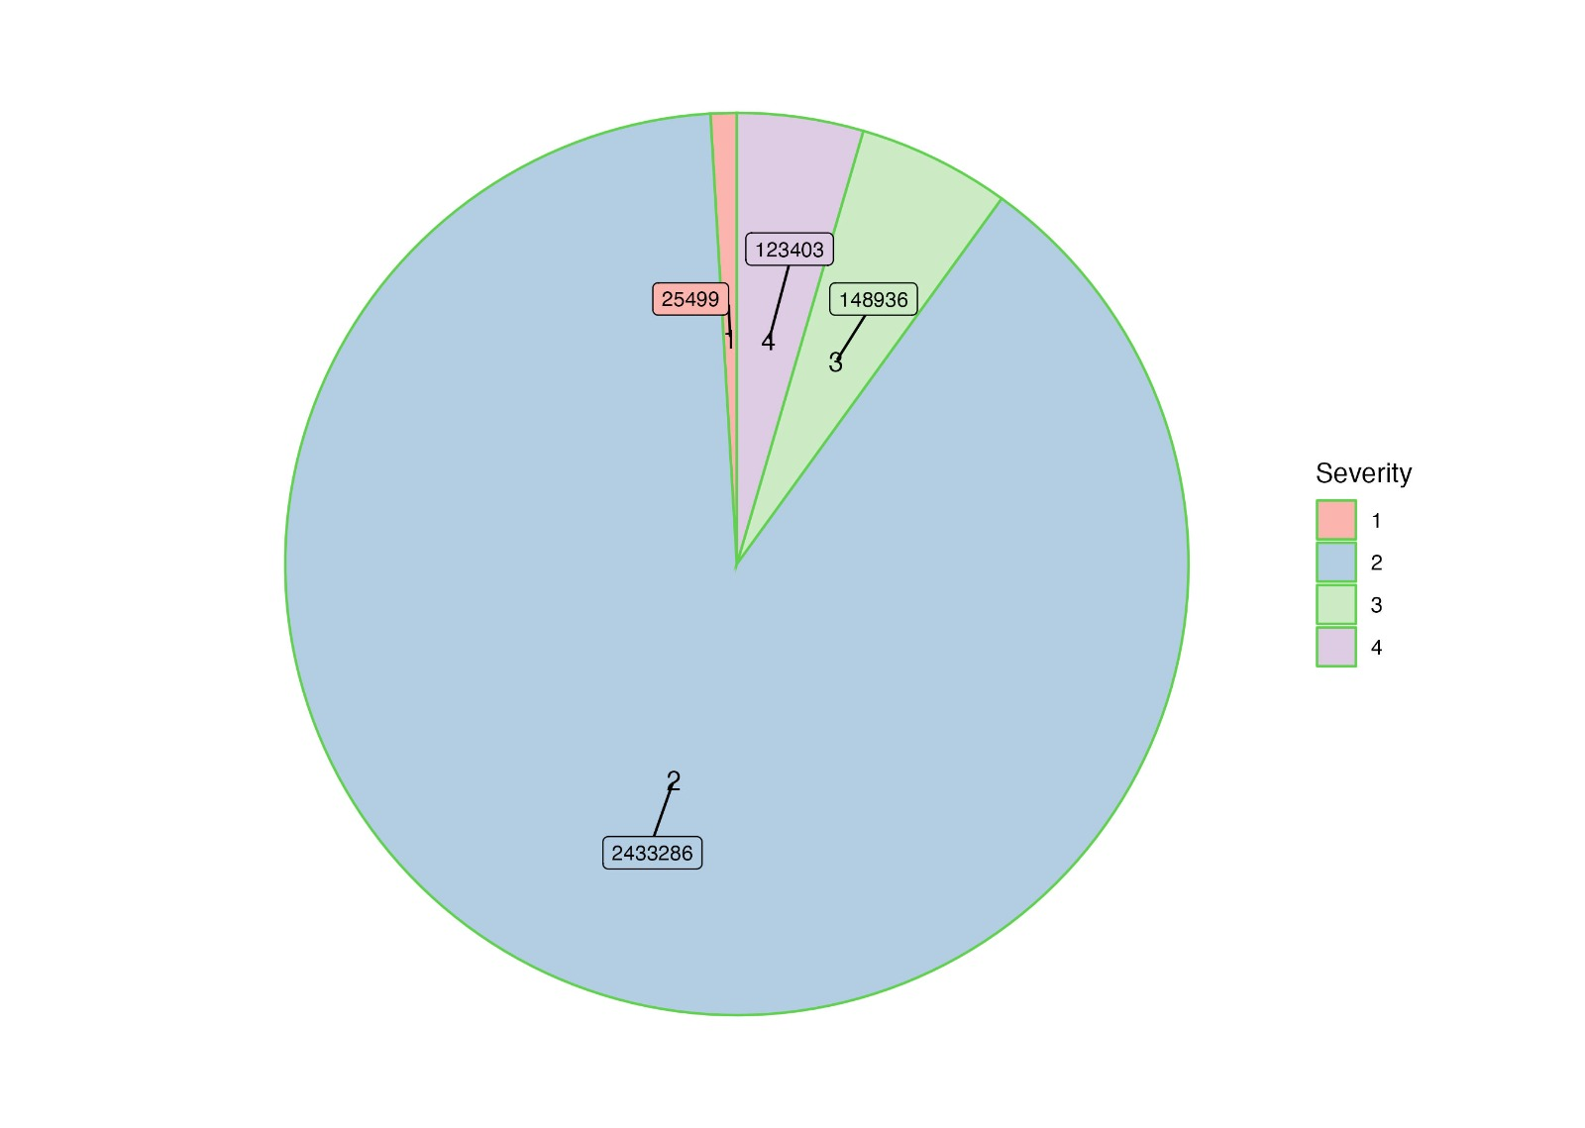
This graph tells us the severity of the accidents which have ratings from 1-4.this tells us that most of the accidents are at the level of 2 and the second most accidents are at the danger level.

Slide 12
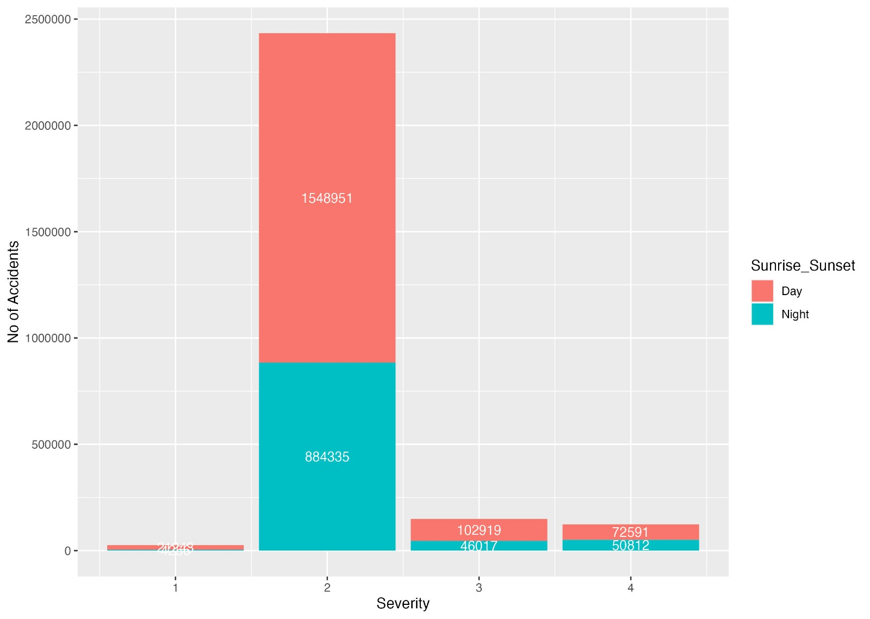
This graph is the Extension of the severity graph. It tells us the severity of accidents happening at what time. here the time is taken as day and night. This tells us that most of the accidents happen in the day time.

Slide 13
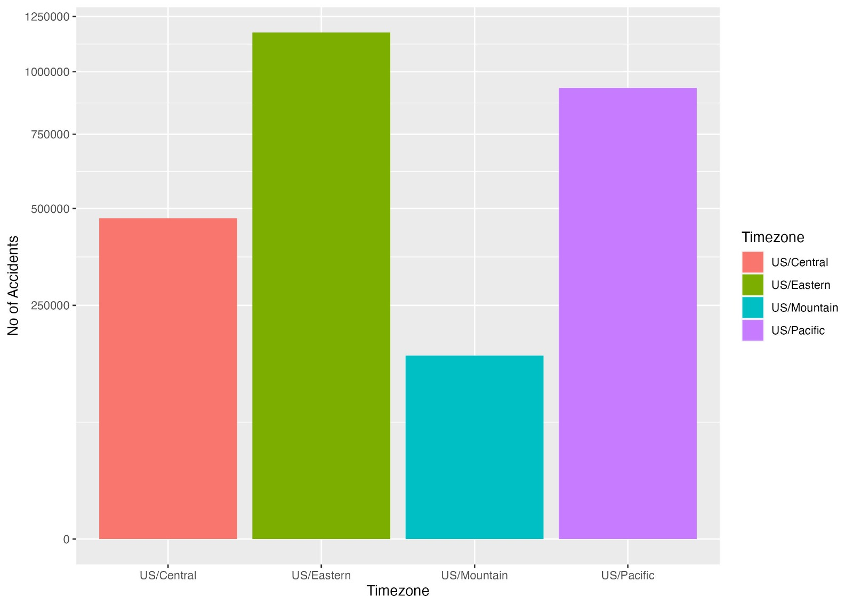
This graph gives information about the accidents that are happening in different time zones across the united states. We can view that the us eastern time zone has the highest record of accidents.

Slide 14
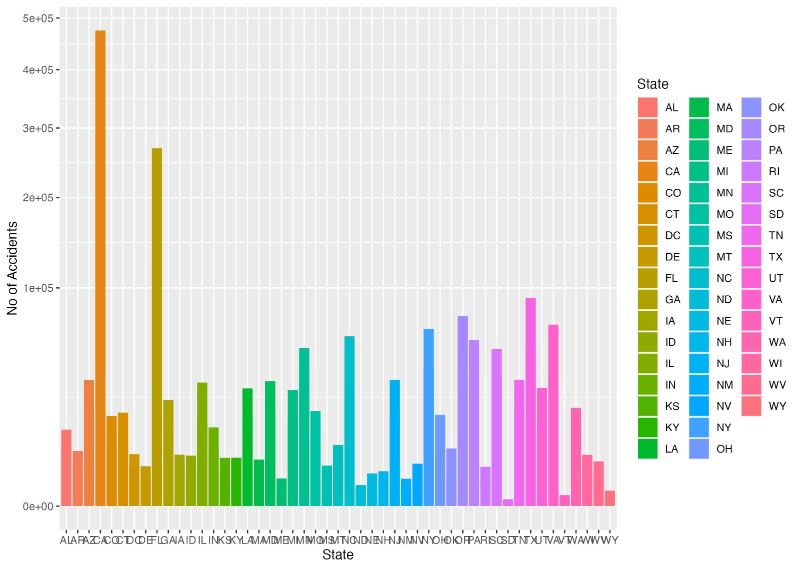
This graph tells about the accidents that are happening in the different states which gives a clear comparison. this graph tells us that the state of CA has the highest record of accidents.

Slide 15
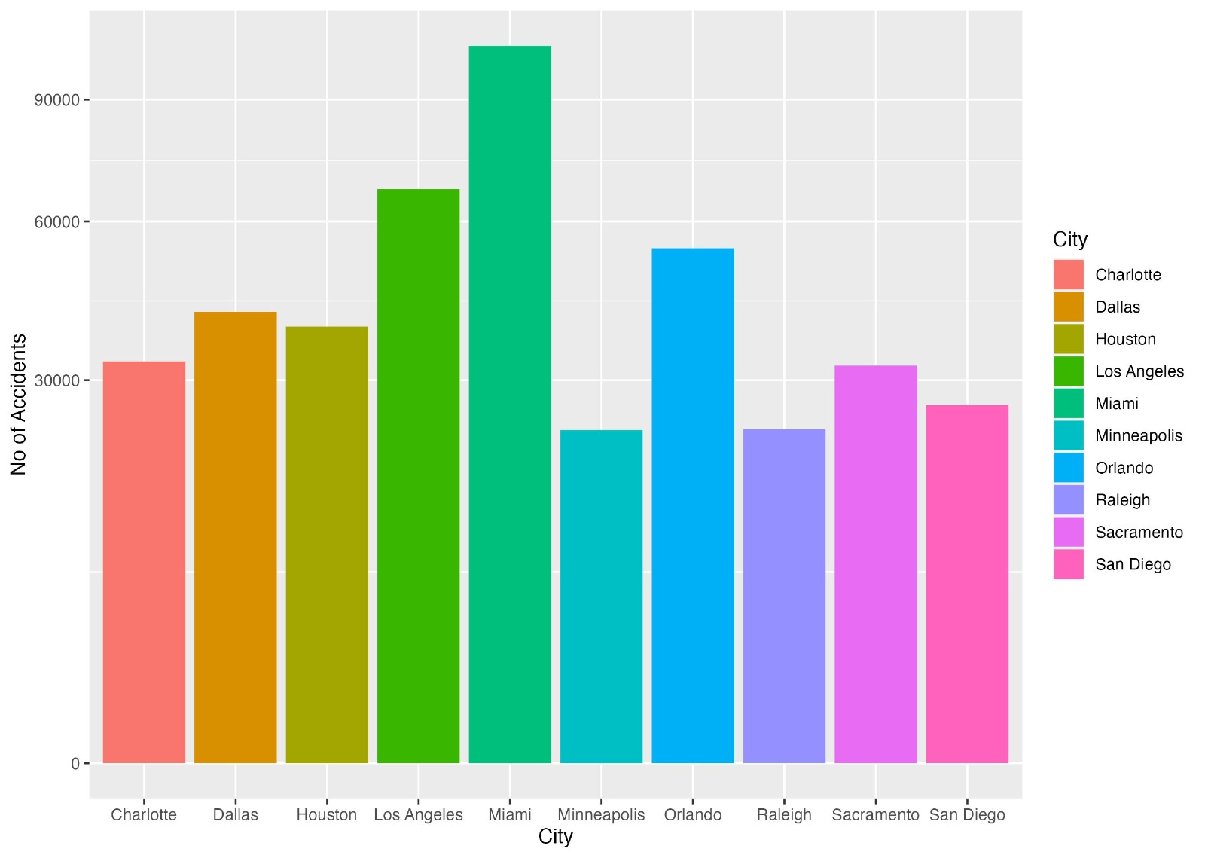
This graph tells us the top 10 cities that have the highest record of accidents. It also gives a comparison of the city which has the highest number of accidents among them.

Slide 16
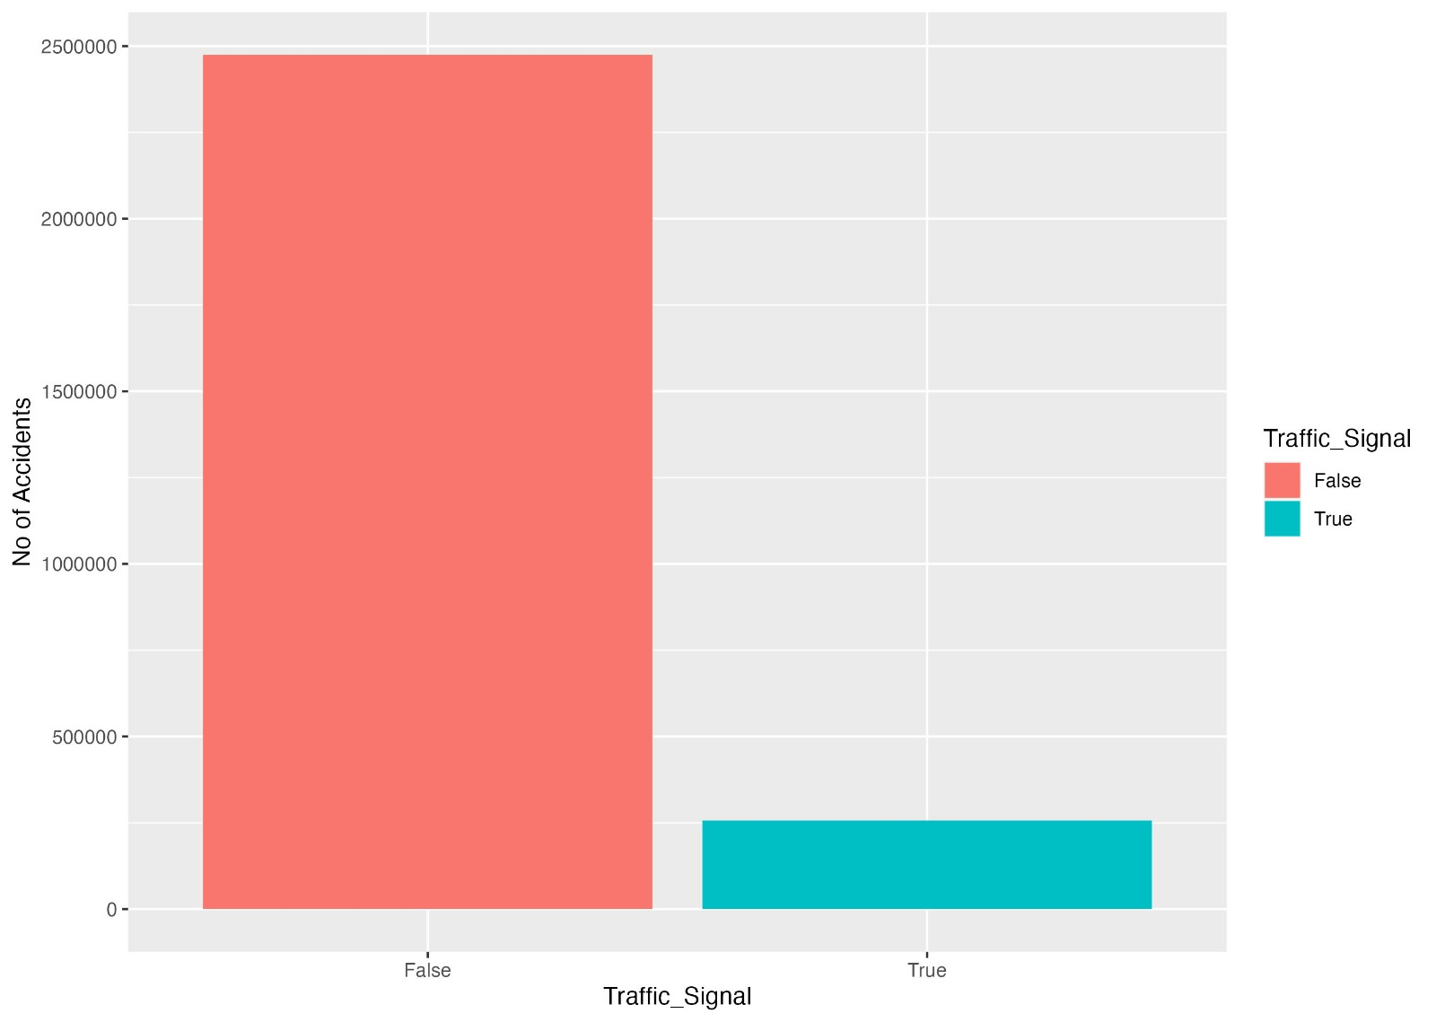
This graph has the factor of Traffic signal which tells us that places without traffic signal has the highest record of accidents. So, accidents can be minimized by having the signals at the right places.

Slide 17
State Accident Percentage by Month

Slide 18
T Tests and Anova
Welch Two Sample t-test
data: train$Sunrise_Sunset_DAY and train$Severity
t = -3179.3, df = 3678781, p-value < 2.2e-16
alternative hypothesis: true difference in means is not equal to 0
95 percent confidence interval:
-1.469906 -1.468095
sample estimates:
mean of x mean of y
0.6198492 2.0888500
Welch Two Sample t-test
data: train$Traffic_Signal and train$Severity
t = -5433.4, df = 3429103, p-value < 2.2e-16
alternative hypothesis: true difference in means is not equal to 0
95 percent confidence interval:
-1.994005 -1.992567
sample estimates:
mean of x mean of y
0.09556363 2.08885004
Anova State Results
Df Sum Sq Mean Sq F value Pr(>F)
train$State 48 25216 525.3 3395 <2e-16 ***
Residuals 1890890 292568 0.2
---
Signif. codes: 0 ‘***’ 0.001 ‘**’ 0.01 ‘*’ 0.05 ‘.’ 0.1 ‘ ’ 1

Slide 19
Correlations
Severity
X 0.148529288
Severity 1.000000000
Start_Lat 0.105132953
Start_Lng 0.103440822
End_Lat 0.105135292
End_Lng 0.103440363
Distance.mi. 0.074554324
Temperature -0.089319507
Wind_Chill.F. -0.096891376
Humidity... 0.037541117
Pressure.in. -0.012231616
Visibility -0.005943754
Wind_Speed 0.037707352
Accident_duration 0.010261259
Year -0.263428516
month -0.070511889
day -0.006207689
Hour -0.012359029
minutes -0.070511889
second -0.272585362
Wind_Chill 0.037707352
Sunrise_Sunset_DAY -0.014360788

Slide 20
Linear Model
lm(formula = Severity ~ State + Traffic_Signal + Temperature +
Humidity... + Crossing + Visibility + Weather_Condition +
1, data = train)
Residuals:
Min 1Q Median 3Q Max
-1.77336 -0.10264 -0.03270 -0.01444 2.09245
Coefficients:
Estimate Std. Error t value Pr(>|t|)
Weather_ConditionHeavy Snow 1.457e-01 3.912e-02 3.726 0.000195 ***
Weather_ConditionLight Freezing Drizzle 1.651e-01 4.374e-02 3.775 0.000160 ***
Weather_ConditionLight Freezing Fog 3.017e-01 4.769e-02 6.327 2.49e-10 ***
Weather_ConditionLight Freezing Rain 3.572e-01 4.027e-02 8.870 < 2e-16 ***
Residual standard error: 0.3893 on 1890835 degrees of freedom
Multiple R-squared: 0.09843, Adjusted R-squared: 0.09838
F-statistic: 2004 on 103 and 1890835 DF, p-value: < 2.2e-16
"The MSE of our test set is: 0.152002352538775"

Slide 21
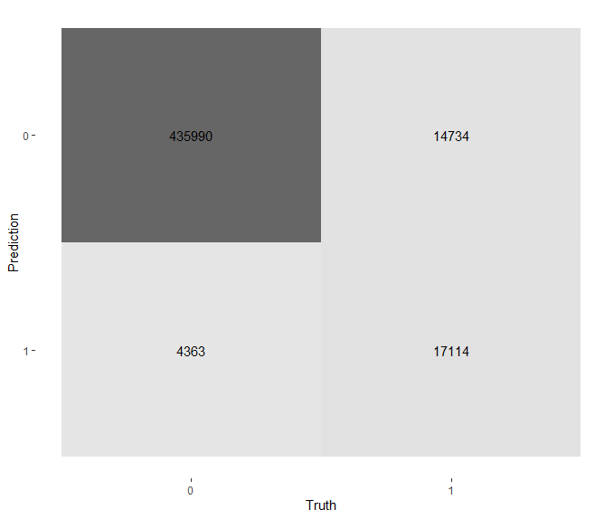
Random Forest
Specificity: 0.537
Sensitivity: 0.990
Precision: 0.967
Recall: 0.990

Slide 22
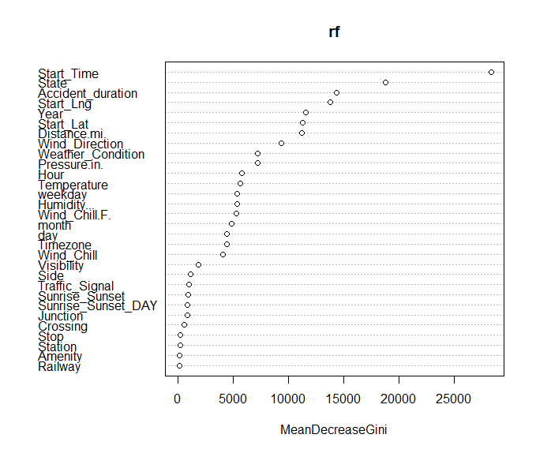
Random Forest

